Slide 1
Gloves off Pre audit
October 2023
Jane O’Neill
Head of QI
Jane McMullen
Senior Sister Critical Care
Service Improvement Lead Nurse for Critical Care
Lynsey Jackson
QI Facilitator

Slide 2
Background
As an NHS Trust, we use numerous amounts of PPE daily
Gloves are no exception. For each single glove that we use, it generates 26g CO2e. On this basis every box of 100 gloves is equivalent to driving 20 miles in a standard petrol car (Rizan et al, 2021; Zhang et al, 2021)
The burning questions are:
Do we overuse gloves when we may not need to?
Does the use of gloves reduce our overall hand hygiene?
We asked all our staff that worked on POCCU to complete a short questionnaire called ‘Goves on, Gloves off’. This was a short quiz to capture whether or not staff would wear gloves for specific tasks.
We did a pre audit observation to look at hand hygiene when working in POCCU. This looked at if staff washed or gelled their hands after a patient contact or a task was completed
We captured how many gloves were used on POCCU annually
Baseline

Slide 3
1. Gloves on, Gloves off questionnaire/ quiz
There have been 105 responses so far from a variety of staff groups

Slide 4
Recommended ‘Gloves off’ tasks
Most people wear gloves for every task when applicable

Slide 5
Recommended ‘Gloves on’ tasks
There are some tasks that people are unsure of whether to wear gloves or not

Slide 6
2. Pre audit hand hygiene observation
218 separate observations were made over a 10-day period on POCCU
Hand hygiene more compliant through night shift
Overall

Slide 7
Observations
218 observations were made on POCCU – these observations included Nursing staff, AHPs, HCAs, Drs/ Consultants, Hygiene Assistants, Porters, Junior Doctors, ANPs
151 (69%) involved wearing gloves
67 (31%) involved no gloves
Out of the 151 observations involving gloves, when removed 46 hand washes were observed and 15 hand gels
Out of the 67 observations with no gloves, 14 hand washes were observed and 10 hand gels
Staff were extremely attentive to patients and supportive to other staff members
Staff were observed going between patients with the same gloves and no hand washing/ gel
Staff regularly keep gloves on to type up notes and then return to the patient with same gloves and no hand washing/ gel
Teas and coffees are served with gloves on
Occasionally gloves were kept on when leaving the unit

Slide 8
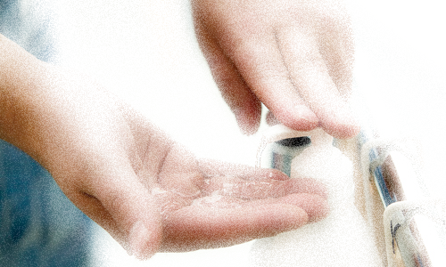
Inadequate Hand Hygiene
61%

Slide 9
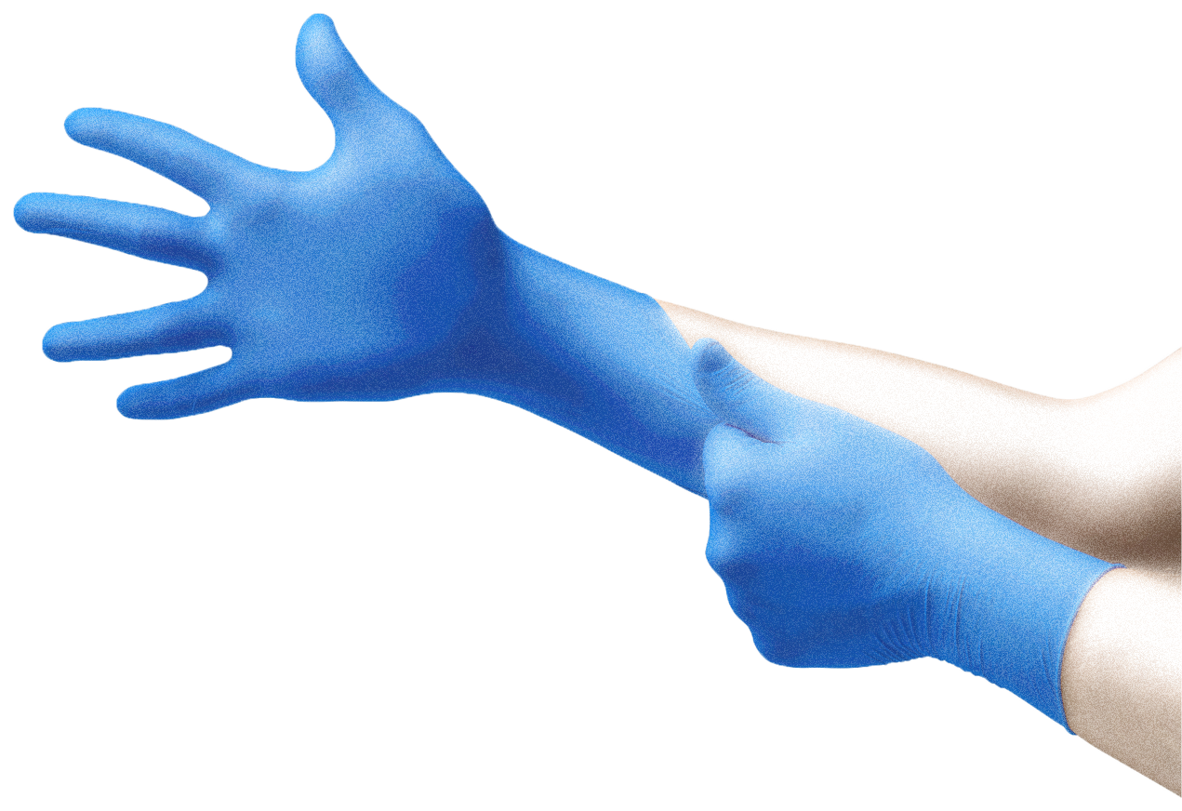
3. GLOVES 6 months on POCCU and ITU at LHCH
~ same cost as a complex CABG with CC score 0-4
Cost
£10,445.76
~2361 gloves used per day
~79 gloves per room
The volume of 1 tonne is ~ a semi-detached house
11.23 Tonnes
CO2e
432,000 single gloves

Slide 10
What next…

Slide 11
References
Rizan C, Reed M, Bhutta MF. Environmental impact of Personal Protective Equipment distributed for use by health and social care services in England in the first six months of the COVID-19 pandemic. medRxiv 2020; doi: https://doi.org/10.1101/2020.09.21.20198911
Zhang E J, Aitchison L P, Phillips N, Shaban R Z, Kam A W. Protecting the environment from plastic PPE BMJ 2021; 372 :n109 doi:10.1136/bmj.n109

